Slide 1
CMSC201
Computer Science I for Majors
Lecture 21 – Searching and Sorting

Slide 2
Last Class We Covered
Dictionaries
  Creating
  Accessing
  Manipulating
  Methods
Hashing
Dictionaries vs Lists

Slide 3
Any Questions from Last Time?

Slide 4
Today’s Objectives
To learn about some sorting algorithms
  Bubble Sort
  Selection Sort
  Quicksort
To learn about searching algorithms
  Linear search
  Binary search

Slide 5
Sorting

Slide 6
Sorting Algorithms
Sorting algorithms put the elements of
a list in a specific order
A sorted list is necessary to be able
to use certain other algorithms
Like search algorithms!
  There must be an order to be able to search – sorting once means we can search quickly forever

Slide 7
Sorting Algorithms
There are many different ways to sort a list
What method would you use?
Now imagine you can only look at
at most two elements at a time
  What method would you use now?
Computer science has a number of
commonly used sorting algorithms

Slide 8
Bubble Sort

Slide 9
Bubble Sort Algorithm
Let’s take a look at a common sorting method!
We look at the first pair of items in the list, and if the first one is bigger than the second one, we swap them
Then we look at the second and third one and put them in order, and so on
Once we hit the end of the list, we start over at the beginning
Repeat until the list is sorted!

Slide 10
Bubble Sort Example
[ 4, 8, 1, 10, 13, 14, 6]
First pass:
4 and 8 are in order
8 and 1 should be swapped:
[ 4, 1, 8, 10, 13, 14, 6]
8 and 10 are in order
10 and 13 are in order
13 and 14 are in order
6 and 14 should be swapped:
[ 4, 1, 8, 10, 13, 6, 14]

Slide 11
Bubble Sort Example (Cont)
[ 4, 1, 8, 10, 13, 6, 14]
Second pass:
4 and 1 should be swapped:
[ 1, 4, 8, 10, 13, 6, 14]
4 and 8 are in order
8 and 10 are in order
10 and 13 are in order
13 and 6 should be swapped:
[ 1, 4, 8, 10, 6, 13, 14]
13 and 14 are in order

Slide 12
Bubble Sort Example (Cont)
[ 1, 4, 8, 10, 6, 13, 14]
Third pass:
10 and 6 should be swapped:
[ 1, 4, 8, 6, 10, 13, 14]
Fourth pass:
8 and 6 should be swapped:
[ 1, 4, 6, 8, 10, 13, 14]

Slide 13
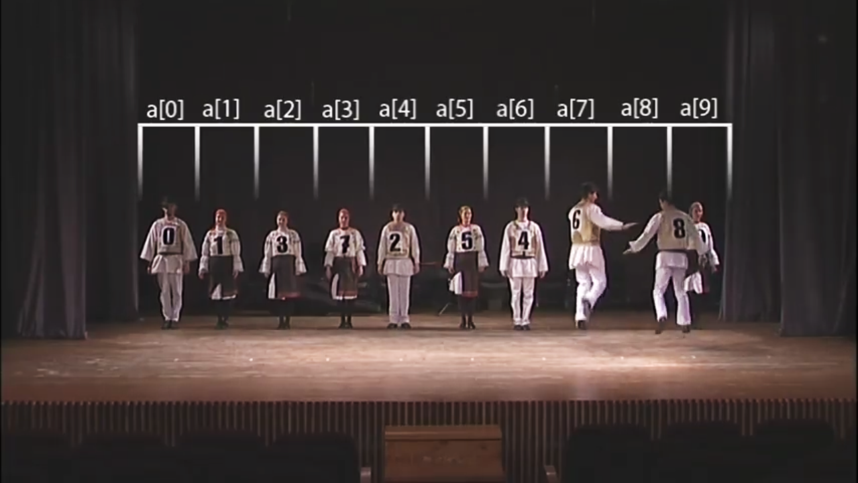
Bubble Sort Video
Video from https://www.youtube.com/watch?v=lyZQPjUT5B4

Slide 14
Selection Sort

Slide 15
Selection Sort Algorithm
Here is a very simple way of sorting a list:
Find the smallest number in a list
Move that to the end of a new list
Repeat until the original list is empty
Unfortunately, it’s also pretty slow!

Slide 16
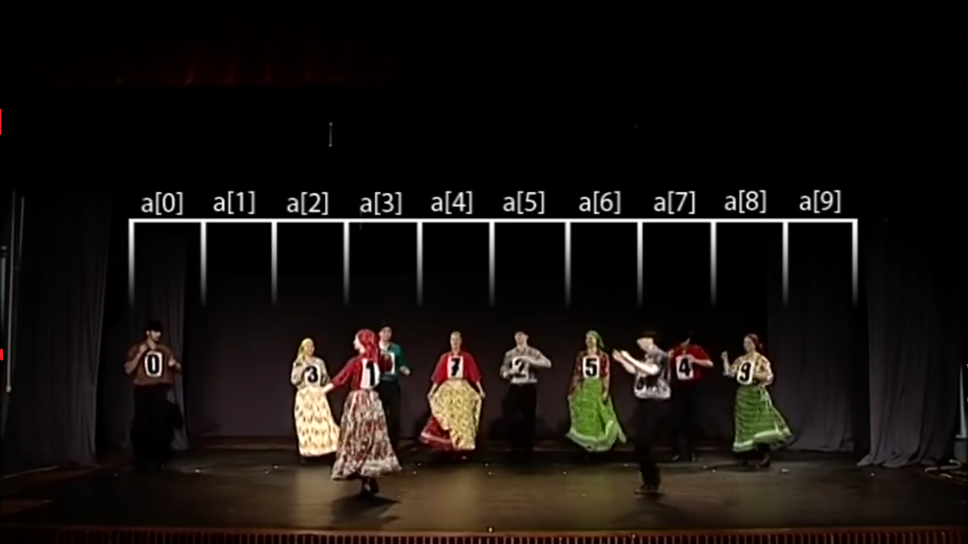
Selection Sort Video
Video from https://www.youtube.com/watch?v=Ns4TPTC8whw

Slide 17
Quicksort

Slide 18
Quicksort Algorithm
Here’s one more method:
Start with any number (the first one works)
Put everything less than that number on the left of it and everything greater than it on the right of it
Quicksort the left side and the right side
Does this method remind you of anything?

Slide 19
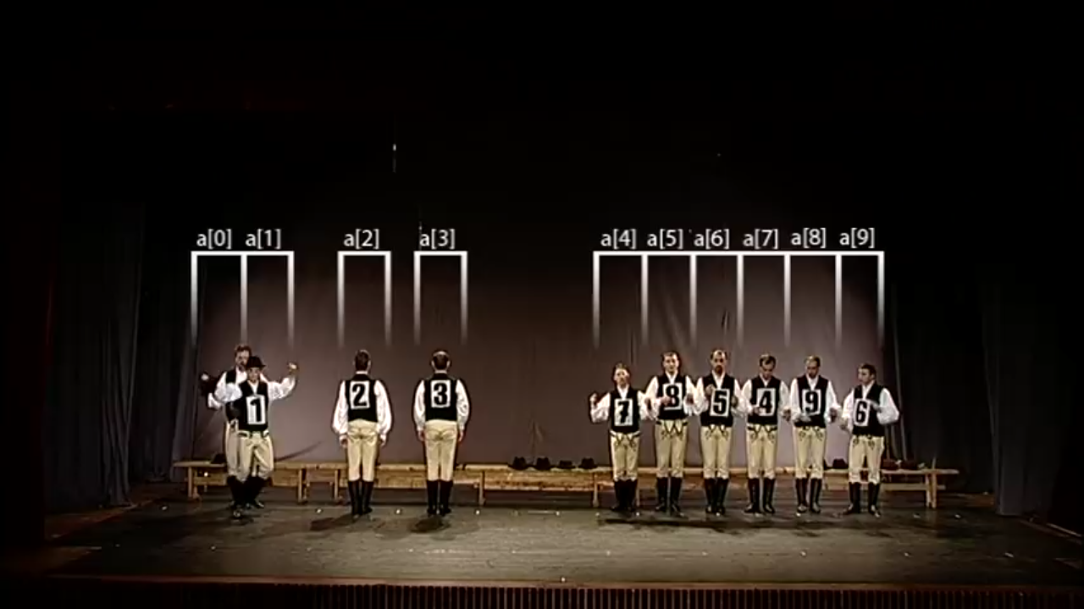
Quicksort Video
Video from https://www.youtube.com/watch?v=ywWBy6J5gz8

Slide 20
Search

Slide 21
Motivations for Searching
Want to know if something exists
  Python can do this for us!
Want to know where something exists
  Python can actually do this for us too!
  raceWinners.index("#718")
But how does Python does this?

Slide 22
Exercise: find()
Write a function that takes a list and a variable and returns the index of the variable in the list
  If it’s not found, return -1
  You can’t use .index()!
    def find(searchList, var)

Slide 23
Exercise: find() Solution
    def find(searchList, var):
    for i in range(len(searchList)):
    if searchList[i] == var:
    return i
    # outside the loop, means that
    # we didn't find the variable
    return -1

Slide 24
Linear Search
You just programmed up a search function!
This algorithm is called linear search
It’s a common, fundamental algorithm in CS
It’s especially useful when our
information isn’t in a sorted order
  But it isn’t very fast

Slide 25
Searching Sorted Information
Now, imagine we’re looking for information in something sorted, like a phone book
We know someone’s name (it’s our “variable”), and want to find their number in the book
What is a good method for
locating their phone number?
  Think about how a person would do this

Slide 26
Algorithm in English
Open the book midway through.
  If the person’s name is on the page you opened to
    You’re done!
  If the person’s name is after the page you opened to
    Tear the book in half, throw the first half away and repeat this process on the second half
  If the person’s name is before the page you opened to
    Tear the book in half, throw the second half away and repeat this process on the first half
This is rough on the phone book, but you’ll find the name!

Slide 27
Binary Search

Slide 28
Binary Search
The algorithm we just demonstrated is
better known as binary search
Binary search is a divide and conquer algorithm
  We’ve talked about these before, remember?
Binary search is only usable on sorted lists
  Why?

Slide 29
Binary Search Example
Find the letter “J” using binary search
A
B
C
D
E
F
G
H
I
J
K
L
M
N
O
0
1
2
3
4
5
6
7
8
9
10
11
12
13
14

Slide 30
Binary Search Example
Find the letter “J” using binary search
A
B
C
D
E
F
G
H
I
J
K
L
M
N
O
0
1
2
3
4
5
6
7
8
9
10
11
12
13
14

Slide 31
Binary Search Example
Find the letter “J” using binary search
A
B
C
D
E
F
G
H
I
J
K
L
M
N
O
0
1
2
3
4
5
6
7
8
9
10
11
12
13
14

Slide 32
Binary Search Example
Find the letter “J” using binary search
A
B
C
D
E
F
G
H
I
J
K
L
M
N
O
0
1
2
3
4
5
6
7
8
9
10
11
12
13
14

Slide 33
Binary Search Example
Find the letter “G” using binary search
A
B
C
D
E
F
G
H
I
J
K
L
M
N
O
0
1
2
3
4
5
6
7
8
9
10
11
12
13
14

Slide 34
Solving Binary Search
Binary search is a problem that can be broken down into
  Something simple (breaking a list in half)
  A smaller version of the original problem (searching that half of the list)
That means we can use ...
recursion!

Slide 35
Time for…
LIVECODING!!!

Slide 36
Exercise: Recursive Binary Search
Write a recursive binary search!
To make the problem slightly easier, make it “checking to see if something is in a sorted list”
  Simply return True or False to answer this
If there’s no “middle” of the list, we’ll just look at the lower of the two “middle” indexes

Slide 37
Exercise: Recursive Binary Search
Write a recursive binary search!
Remember to ask yourself:
  What is our base case(s)?
  What is the recursive step?
  def binarySearch(theList, item):
A hint: in order to get the number at the middle of the list, use this bit of code:
myList[len(theList) // 2]

Slide 38
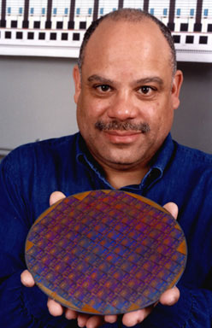
Daily CS History
Mark Dean
  Holds 3 of 9 patents for the IBM PC
  Part of team that developed the ISA
  bus (used to connect I/O devices)
  Led design of the 1-gigahertz chip
  Computing visionary
    Predicted the tablet computer in 1999
    https://web.archive.org/web/20121020094411/
    http://www.usnews.com/usnews/culture/articles/
    000103/archive_034033.htm
Notes:
Early in the next century, Dean hopes his new concoction, which he says is "in the idea and invention stage," will be ready for the public: a sleek tablet that is magazine-size, inexpensive, programmable, and voice-activated. He expects his unnamed dream pad, which will run on a 24-hour battery, to provide everything a PC does, including streaming audio and video, word processing, and spreadsheets. It will even have a port for old fogies who can't give up their keyboards. And it will wirelessly put the Internet and other information at your fingertips.

Slide 39
Announcements
Watch for a Blackboard announcement about Project 3 today
Final exam is Friday, December 14th at 6 PM
Course evaluations should be out to you soon, please take the time to fill them out
  Especially for this class!

Slide 40
Image Sources
Sorting video screenshots:
  Bubble sort:
    https://www.youtube.com/watch?v=lyZQPjUT5B4
  Selection sort:
    https://www.youtube.com/watch?v=Ns4TPTC8whw
  Quicksort:
    https://www.youtube.com/watch?v=ywWBy6J5gz8
Mark Dean:
  http://www.blackpast.org/aah/dean-mark-1957
    http://www.blackpast.org/files/blackpast_images/Mark_Dean__Stanford_University_News_Archive_.jpg

